Slide 1


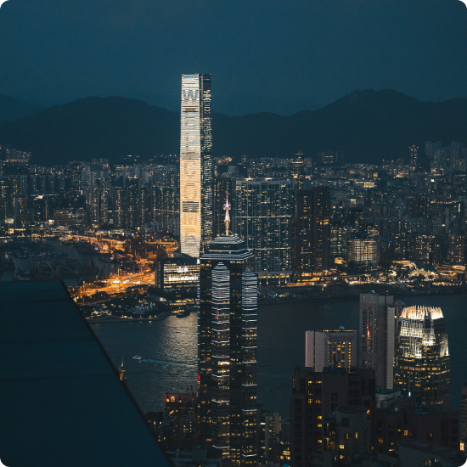

AM CONSTRUCT
Transforming Spaces
Structural Design | Planning | Elevation | Construction Solutions
ABDUL SATTAR K
B.E., M.Tech (Structures)

Slide 2



About AM CONSTRUCT
Innovative, safe, and practical engineering solutions for modern infrastructure. We combine technical expertise with sustainable practices to build a better future.
Expertise
Innovation
Trust
Structural Engineering Excellence
Advanced Architectural Planning
Practical Construction Solutions

Slide 3
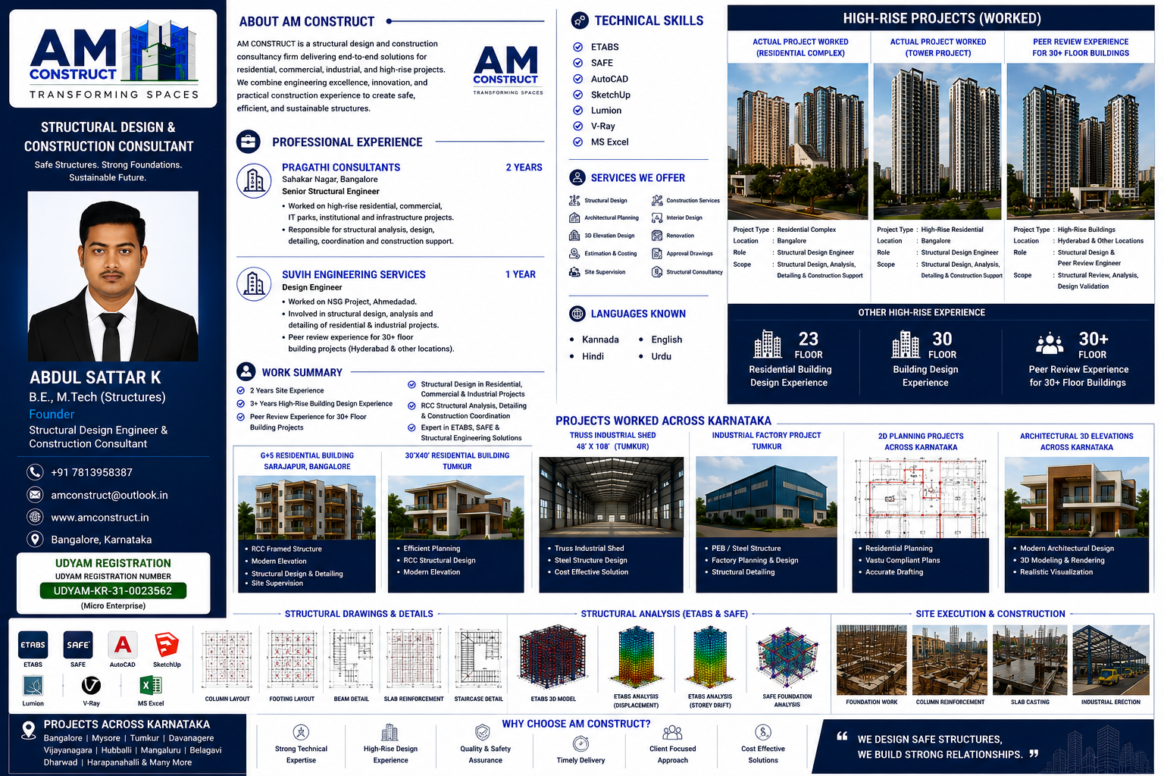
Founder Profile
ABDUL SATTAR K
Founder & Structural Design Engineer
B.E., M.Tech (Structures)
3+ Years High-Rise Design Experience
Peer Review for 30+ Floor Projects
Expert in RCC Analysis & Detailing
Kannada | English | Hindi | Urdu

Slide 4

Professional Experience
Pragathi Consultants
Suvih Engineering Services
Senior Structural Engineer | 2 Years
Structural Design Engineer | 1 Year
High-rise residential & commercial
Worked in NSG Project — Ahmedabad
Institutional structures design
Structural analysis & validation
Detailed RCC Analysis & Detailing
Peer Review of complex designs

Slide 5
Work Summary
23-Floor Residential Buildings Experience
Industrial Steel Structure Experience
30-Floor Building Design
Site Execution Coordination
30+ Floor Peer Review Experience
Structural Detailing Mastery
ETABS & SAFE Advanced Modelling
Safety & Design Optimization

Slide 6


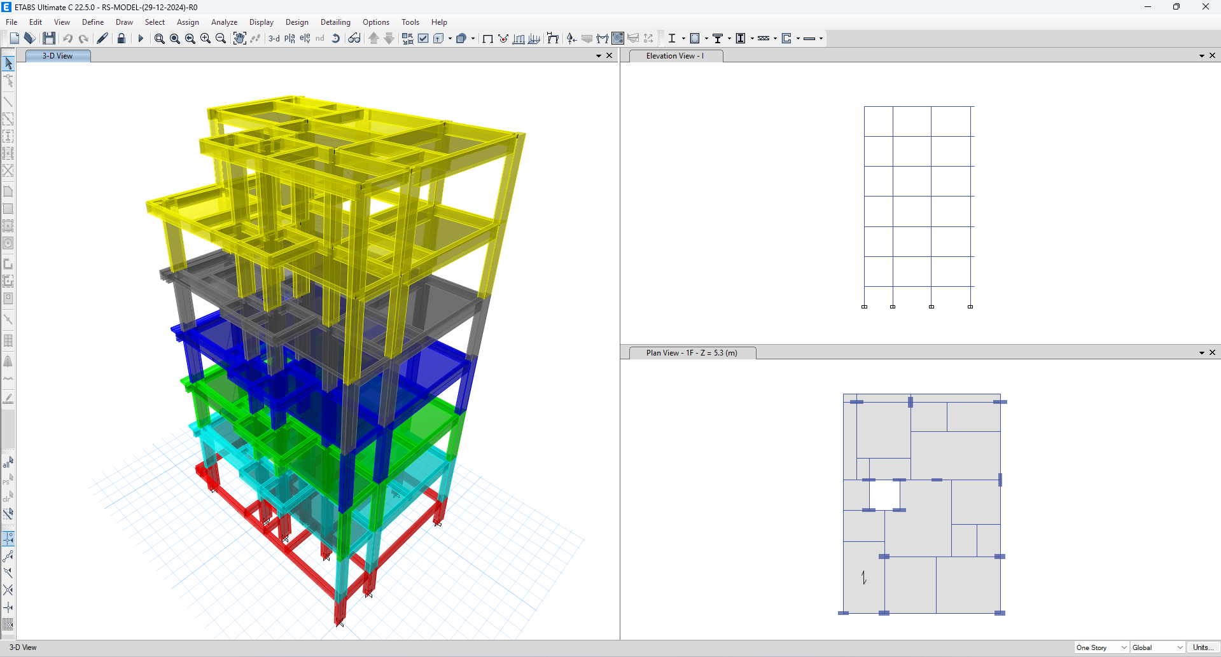
Software Proficiency
ETABS
SAFE
AutoCAD
V-Ray
Lumion
SketchUp

Slide 7






Comprehensive Services
Structural
Architectural
Construction
RCC Design, Foundations, Columns, Beams, Slabs, and specialized Structural Consultancy.
Planning, 3D Elevations, Interior Concepts, and Approval Drawings.
Site Supervision, Management, Estimation, and Renovations.

Slide 8
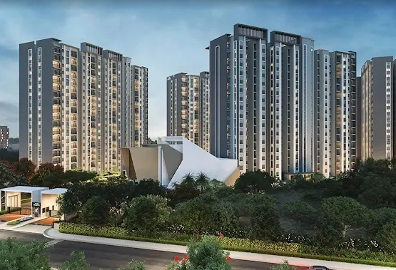

High-Rise Expertise
Landmark Skyscrapers
We specialize in the complex design and analysis of multi-story towers in Bangalore and beyond.
23 & 30 Floor Residential Experience
30+ Floor Peer Review Engineering
Advanced RCC Analysis & Detailing

Slide 9
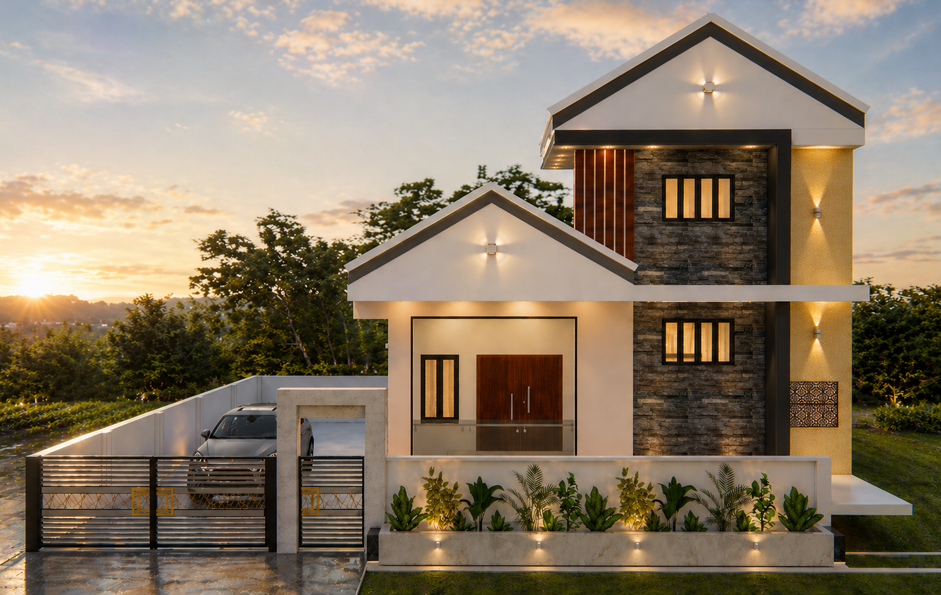

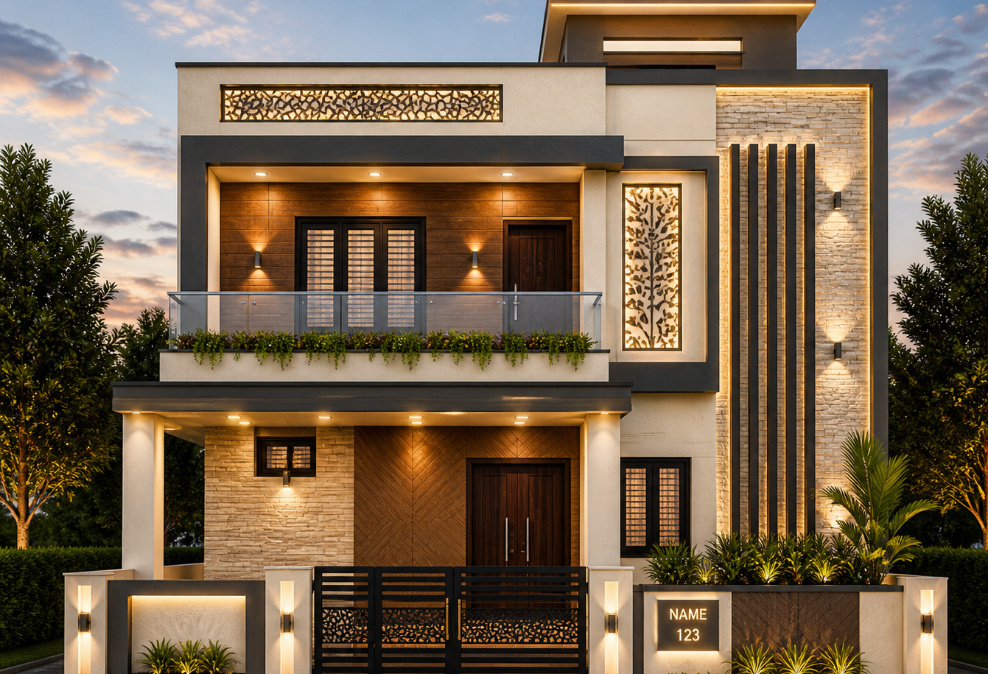
Residential Portfolio
Modern Luxury Villas
Premium Apartments
30x40 Urban Planning

Slide 10
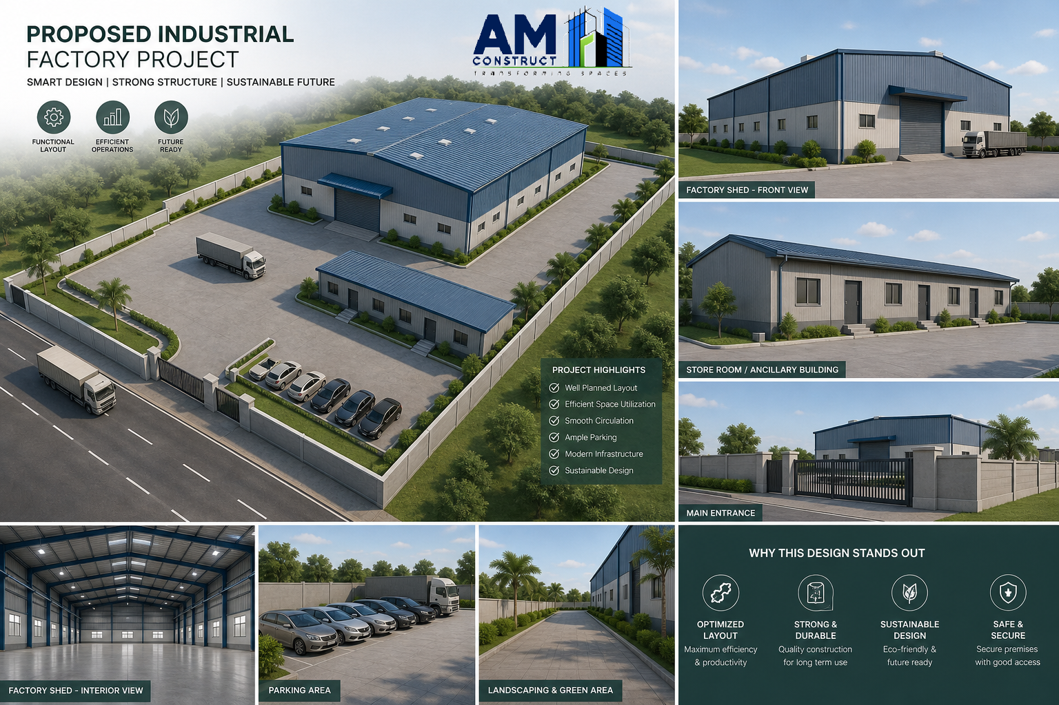
Industrial Project Experience
Industrial Excellence
Pre-Engineered Buildings (PEB)
Truss Industrial Shed Design
Large Warehouse Planning
Steel Structure Optimization

Slide 11
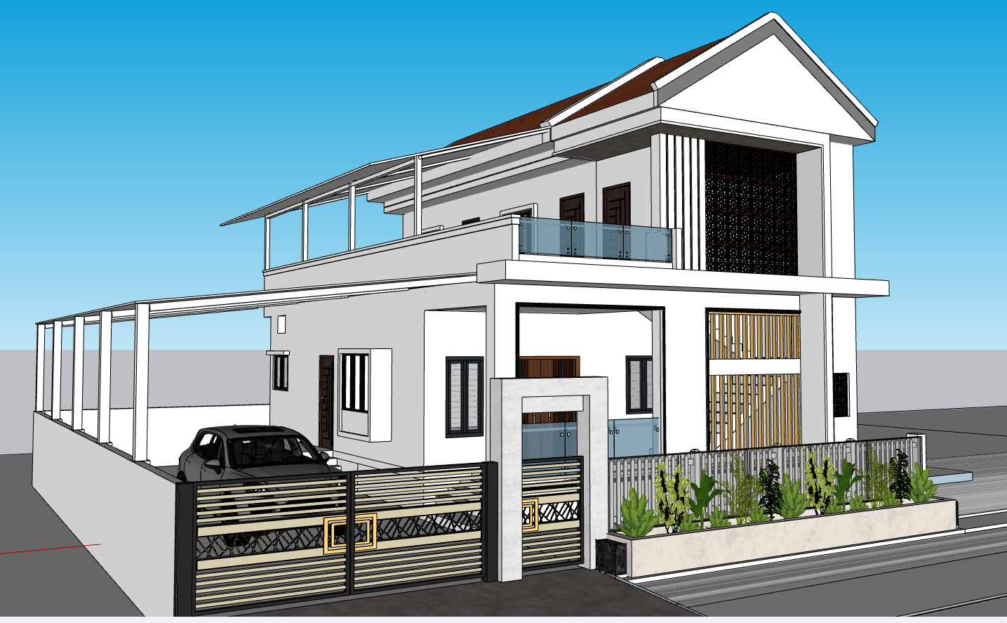
Architectural Visualization
Bringing Concepts to Life
We provide high-end exterior renders with realistic textures and lighting. Our 3D visualizations help clients envision their projects before a single brick is laid.
Day & Night Renders
Modern Facade Concepts
High-Resolution Walkthroughs

Slide 12

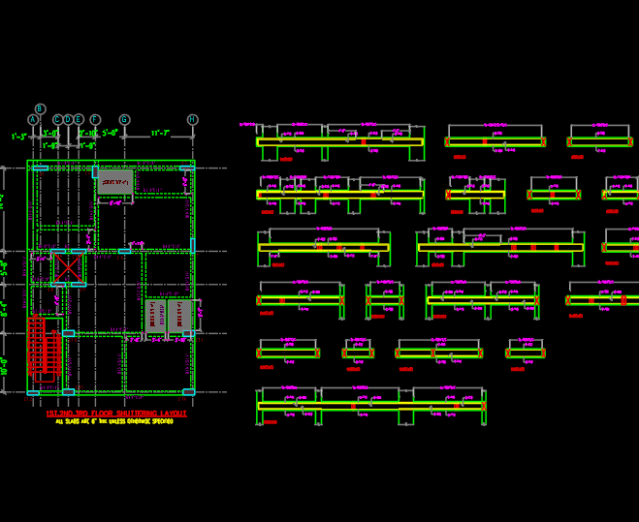
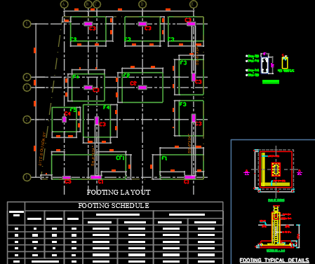
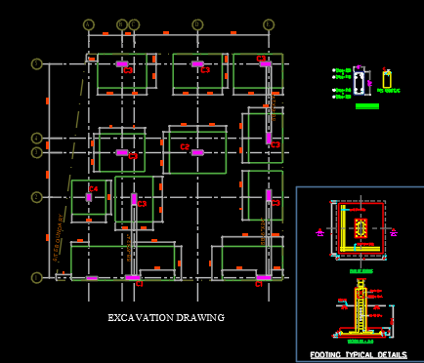
Structural Drawings & Detailing
Footing Layouts
Beam & Slab Detailing
Foundation Technical Plans

Slide 13

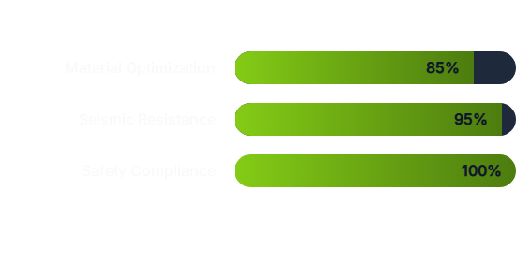
Advanced Structural Analysis
Optimization via Analysis
"Safety compliance is our core priority. We use finite element analysis (FEA) to ensure load paths are optimized."

Slide 14
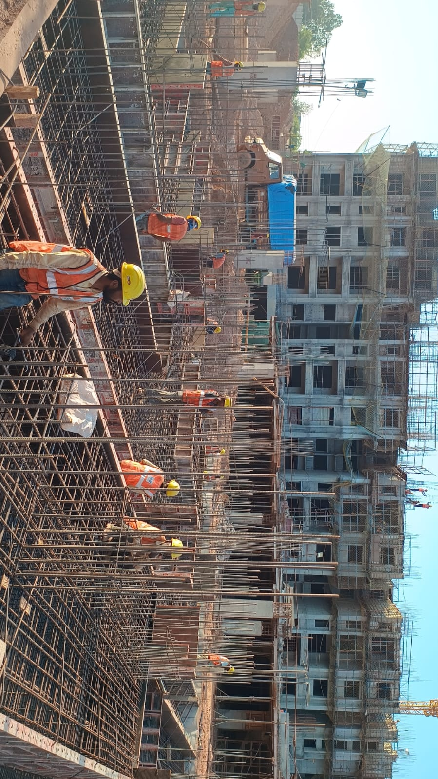
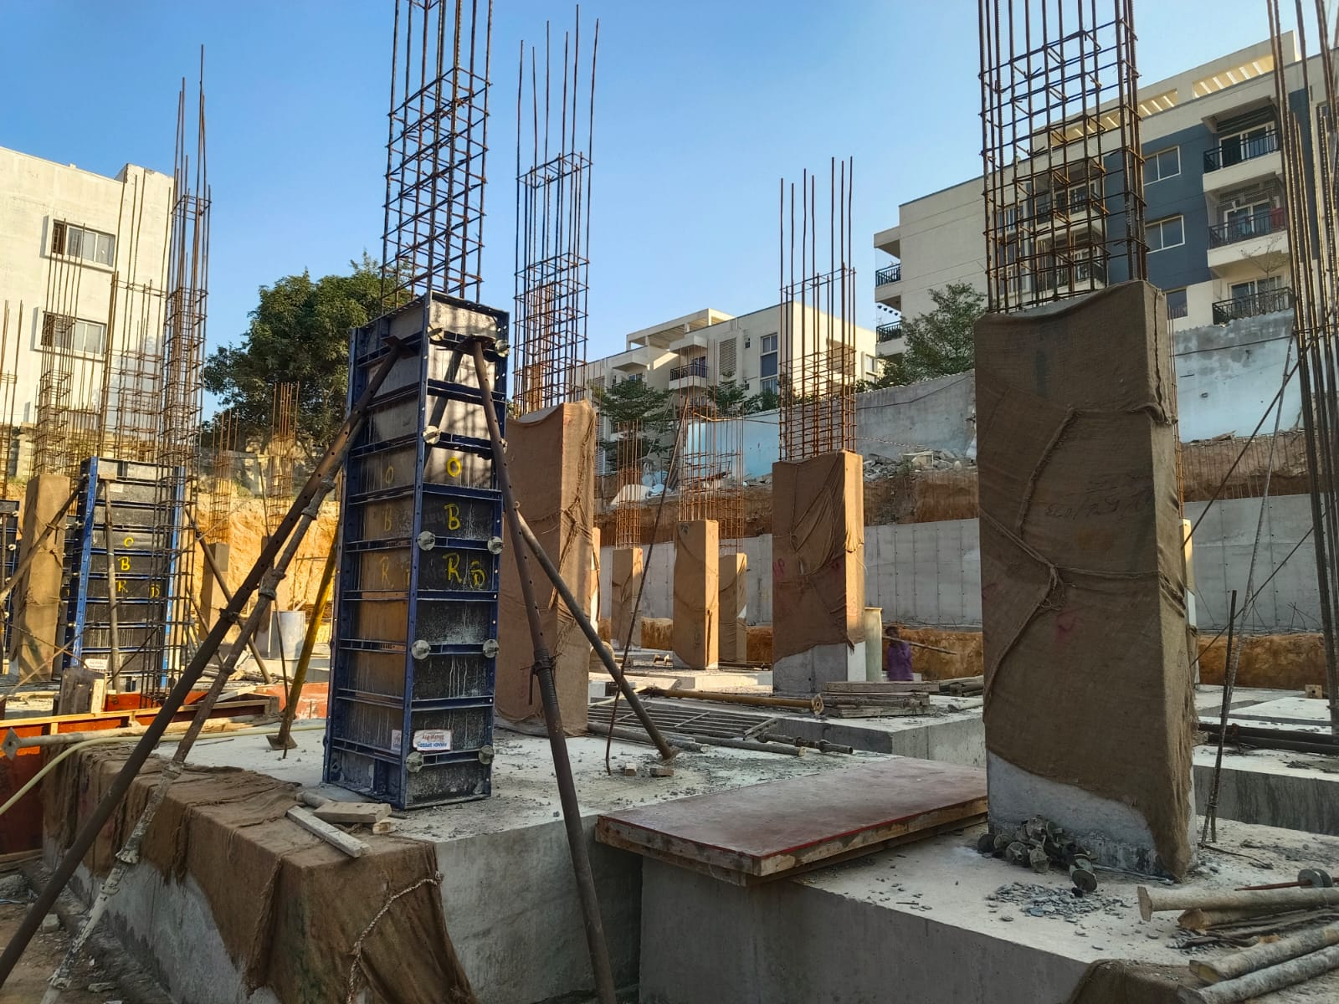
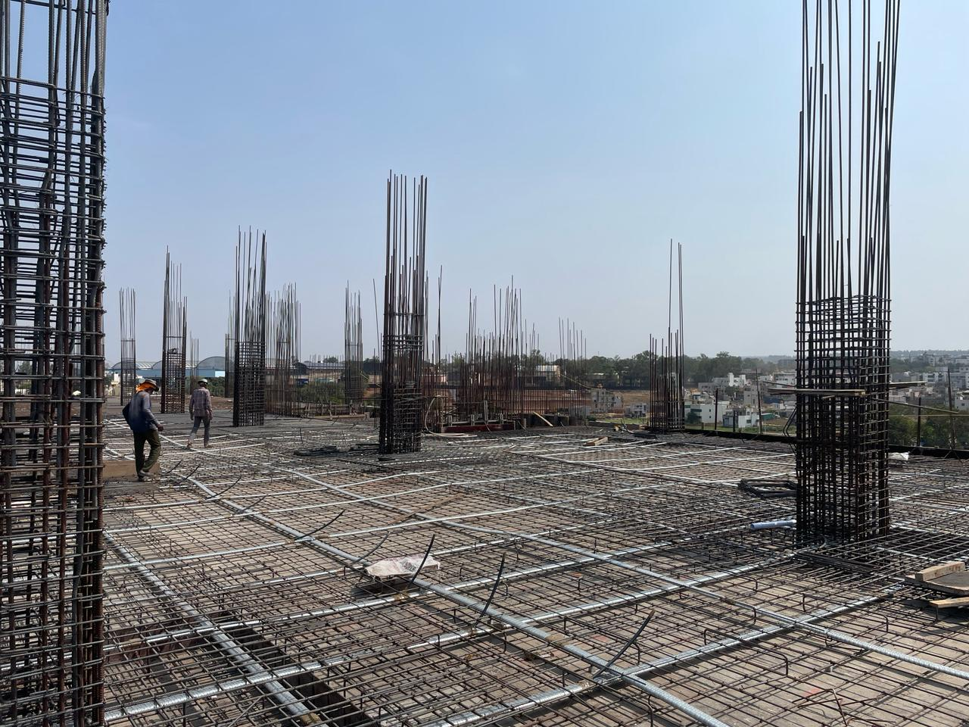
Site Execution & Construction
Foundation Work
Column Reinforcement
Slab Casting
Combining practical construction knowledge with engineering precision for faultless execution.

Slide 15






Projects Across Karnataka
10+
15+
MAJOR CITIES
PROJECTS COMPLETED

Slide 16


Why Choose AM CONSTRUCT?
Technical Accuracy
Client Focused
Timely Support
Precise designs that stand the test of time and environmental stresses.
Tailored solutions meeting specific aesthetic and budget needs.
Ensuring project timelines are met with rapid design turnarounds.

Slide 17

Company Trust & Verification
UDYAM REGISTRATION
UDYAM-KR-31-0023562
VERIFIED MICRO ENTERPRISE

Slide 18


Contact AM CONSTRUCT
"We Design Safe Structures, We Build Strong Relationships."
7813958387
LOCATION
Anjuman Shadi Mahal Opposite, Hospet Road, Harapanahalli Taluk,Vijayanagara District, Karnataka – 583131
ceo@amconstruct.in
amconstruct@outlook.in
@amconstruct.in
AM CONSTRUCT Portfolio

